Slide 1
Performance Analysis of Machine Learning
Classifiers for Malicious Identification
Submitted in the partial fulfillment for the award of the degree of
BACHELOR OF ENGINEERING
IN
COMPUTER SCIENCE AND ENGINEERING WITH AIML
Submitted by:
Vamsi Krishna Chirala (22BAI71026)
Bhavani Prasad (22BAI70470)
Prabhath (22BAI70029)
Under the Supervision of:
Prof. Shanu
Department of AIT-CSE
DISCOVER . LEARN . EMPOWER

Slide 2
Outline
Introduction to Project
Problem Formulation
Objectives of the work
Methodology used
Results and Outputs
Conclusion
Future Scope
References

Slide 3

Introduction

Slide 4
Introduction to Project
Cybersecurity threats are increasing rapidly due to digital transformation
Traditional rule-based systems fail to detect unknown attacks
Machine Learning provides adaptive and intelligent detection
Helps in identifying malicious patterns from large-scale data
Enables automated and faster decision-making

Slide 5
Problem Formulation
Existing systems suffer from high false positive rates
Difficulty in detecting zero-day and evolving attacks
Large volume of network data makes manual analysis difficult
Need for efficient, accurate, and scalable detection system
Lack of comparative analysis among multiple ML models

Slide 6
Objectives of the Work
To analyze performance of various ML classifiers
To improve detection accuracy and reduce false alarms
To extract meaningful features from raw data
To compare models using standard evaluation metrics
To identify the best-performing classifier for malicious detection

Slide 7
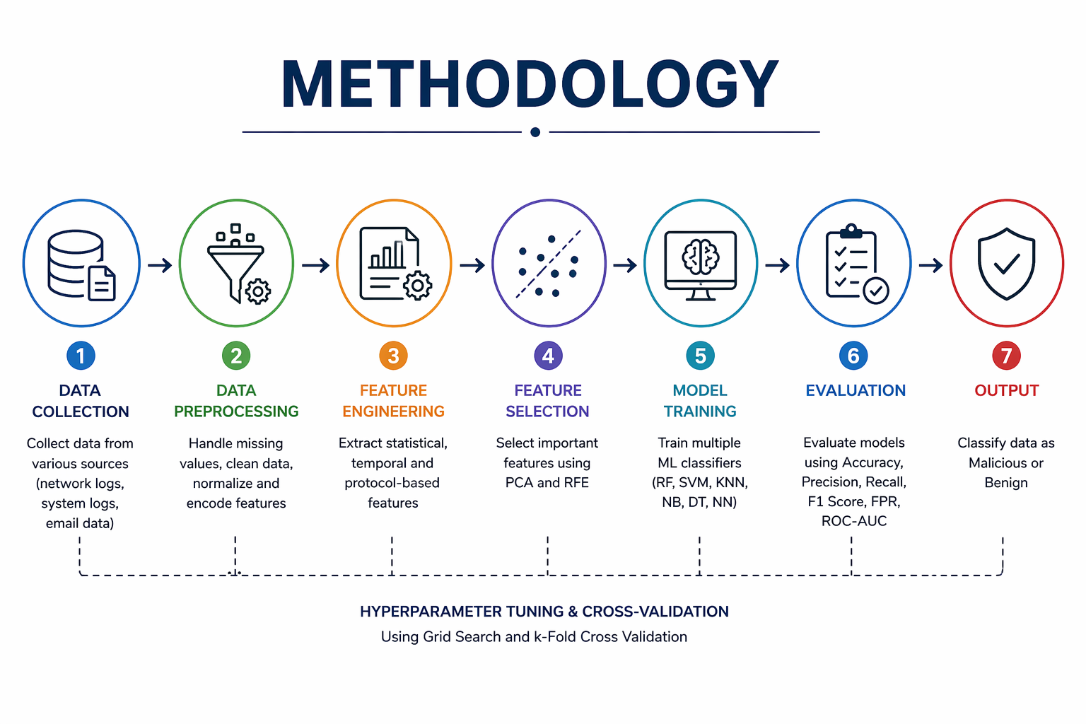

Slide 8
Methodology used
Data collected from benchmark datasets (KDD Cup 99, CICIDS 2017, UNSW-NB15)
Data preprocessing: cleaning, handling missing values, normalization
Feature engineering: statistical, temporal, and protocol-based features
Feature selection using PCA and RFE to reduce dimensionality
Multiple ML models trained (RF, SVM, KNN, NB, DT, NN)
Hyperparameter tuning using Grid Search and Cross-Validation
Models evaluated using standard performance metrics

Slide 9
Results and Outputs
All models were evaluated using accuracy, precision, recall, and F1-score
Random Forest and Neural Network showed higher accuracy compared to others
Reduced false positive rate achieved after feature selection
System successfully classified data into:
Malicious
Benign
Output includes detection results and alert generation

Slide 10
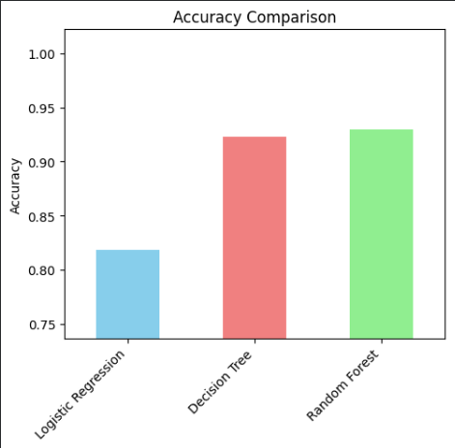
Result and Output

Slide 11
Conclusion
Machine Learning improves accuracy of malicious detection systems
Comparative analysis helps identify the most efficient classifier
Feature selection significantly enhances performance
The proposed system is effective, scalable, and reliable
Provides a strong foundation for intelligent cybersecurity solutions

Slide 12
Future Scope
Implementation using deep learning models (CNN, RNN)
Real-time intrusion detection system development
Integration with cloud platforms (AWS, Azure)
Use of AI-based adaptive and self-learning systems
Deployment in real-world enterprise environments

Slide 13
References
[1] S. Axelsson, “Intrusion detection systems: A survey and taxonomy,” Technical Report, Chalmers University of Technology, 2000.
[2] D. E. Denning, “An intrusion-detection model,” IEEE Transactions on Software Engineering, vol. SE-13, no. 2, pp. 222 232, 1987.
[3] W. Lee and S. J. Stolfo, “Data mining approaches for intrusion detection,” Proceedings of the 7th USENIX Security Symposium, pp. 79–94, 1998.
[4] K. Kendall, “A database of computer attacks for the evaluation of intrusion detection systems,” MIT Master’s Thesis, 1999.

